Slide 1
SPLASH 2021
14784-PHYSICS OF LASER
20 NOVEMBER 2021
Room # 10
TIME : 3.05 pm to 3.55 pm

Slide 2
MONOCHROMATIC LASER LIGHT
WHAT IS COLOR?
Color is a property defined by the wavelength of light. Different colors of light have different wavelengths. When you look at a red object, it looks red because the object is reflecting red light.
When light consists of only one wavelength of light, we say it is monochromatic (from ancient Greek, mono meaning “alone” or “single”, and chromatic meaning color).

Slide 3
WHITE LIGHT
So what color is the light emitted from the sun, or the overhead lights? Yellow? White? Does it even have a color?
Yes, it does! This light is called white light, and despite its name, it’s actually made up of a combination of colors. White light from the sun is made up of all the colors of you rainbow, it just looks white to you when they are all together. This is why you can see all the different colors of objects when the sun shines or from the light of a flashlight. Every wavelength of light is available to be reflected or absorbed, so every color has the potential to be visible.

Slide 4
LASER- Light Amplification by Stimulated Emission of Radiation.
Laser light is different from a monochromatic light due to certain inherent properties. They are directionality, monochromaticity, coherence, intensity and brightness.
In order to explain monochromaticity, which means having a single wavelength, I am going to compare the light emitted by an ordinary sodium vapor lamp(like in streetlights) and the laser emitted light.
https://youtu.be/y-JCF3K9ntc

Slide 5

COLLIMATED LASER LIGHT
Laser pointers are often used during presentations, to highlight important points information. One could not do this with a normal flashlight, though, because the light spreads to quickly to be a useful pointing tool!
Why can LASERs shine so much further than LED or flashlights, without spreading out or getting dimmer?
HOW LIGHT MOVES
We can represent a beam of light as a collection of light rays, as shown in Figures 1 and 2 below. These light rays follow a very specific set of rules. The most important of these is that these rays always travel in straight lines. They cannot curve, and unless they are refracted , they cannot bend.

Slide 6
Collimated Light
WHY IS LIGHT BRIGHT?
The light rays making up a beam of light can be arranged in a lot of different ways. This affects how bright the light is.
Figure 1

Slide 7
Collimated Light
Figure 2

Slide 8

Collimated Light
Often, when the rays of a beam of light leave its source, like an LED or flashlight, the light rays start to spread out as shown above. This means the beam starts out brightly but loses intensity as the rays move further away from each other.
When the rays don’t spread out, but instead remain parallel to each other over long distances, we say the beam of light is collimated.

Slide 9
COLLIMATED LIGHT IN REAL LIFE: MICROSCOPY
While parallel light rays are a well-known property of LASERs, you can collimate any light source with the right equipment. One of the uses of collimated light is in microscopes.
In order to ensure clear, accurate images in high-powered microscopes, a collimated beam of light must travel from the light source below the specimen being viewed, to the eyepiece. This light can originate from either a LASER or an LED.

Slide 10
COHERENT LASER LIGHT
What is coherence?
A beam of light consists of several rays of light. Each ray of light can be represented as a wave, like a wave in the ocean, also called a transverse wave. When all the waves of light in a beam are in step, or in phase, we say the light is coherent such as that shown in the diagram below.
Figure 3

Slide 11
COHERENT LASER LIGHT
If two rays of light are in step or in phase, it means their crests (and troughs) sync up. Figures 3 and 4 show the difference between coherent and incoherent light. In Figure 1, you can see the peaks of the waves are all aligned, forming a coherent beam of light. In Figure 4, the peaks are randomly aligned - this is an incoherent beam of light.
Figure 4

Slide 12
INTERFERENCE AND SPECKLE PATTERNS
When two rays of light meet, they can interact with each other through a process called interference. . Thinking of the light as waves in the ocean or on a pond, if two crests meet, constructive interference occurs, and the wave gets bigger; the resulting ray is amplified. If a crest and a trough meet, the waves experience destructive interference, and the resulting wave is diminished or cancelled out.
Remembering the concept of diffuse reflection mentioned earlier think of many waves bouncing off a rough surface. When an incoherent beam of light is diffusely reflected, the rays of light cross each other and interfere, but the results are completely random. So any changes are smeared out and the brightness of the beam of still looks the same everywhere.
.

Slide 13
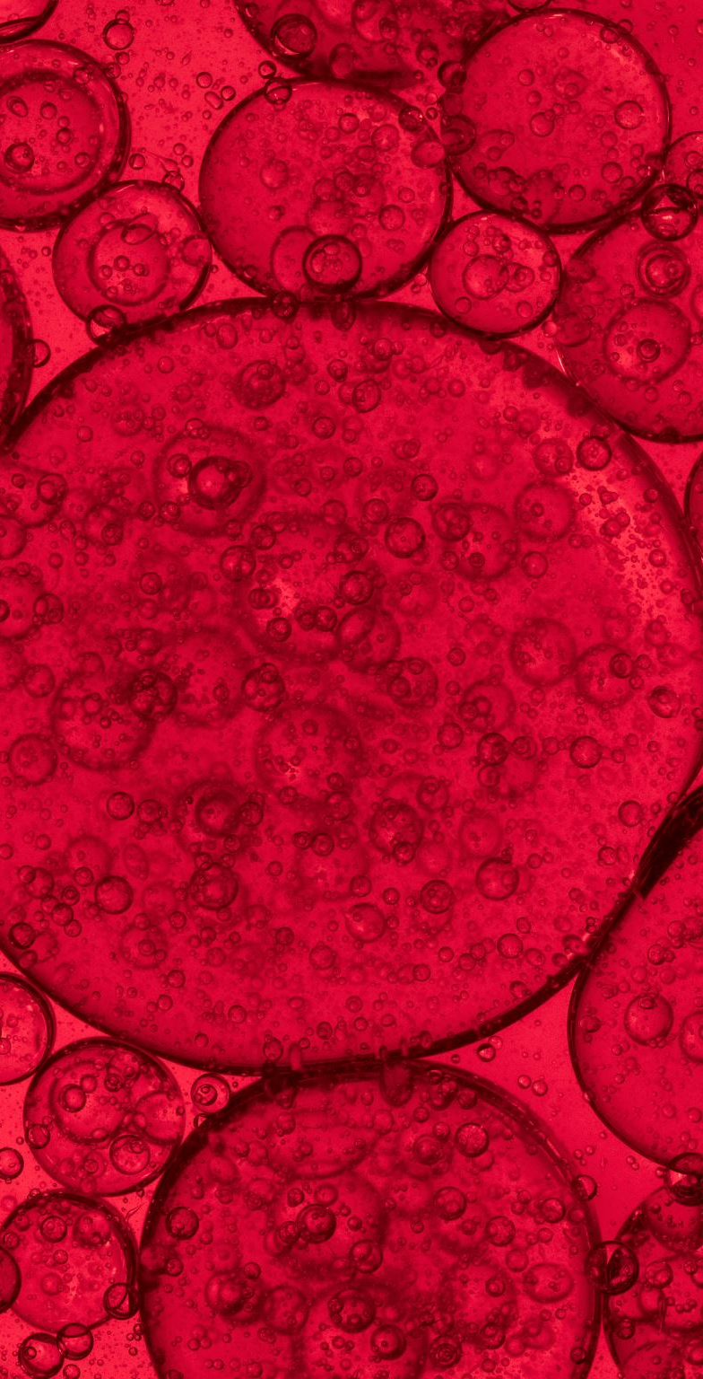
COHERENT LIGHT IN REAL LIFE: MONITORING BLOOD FLOW
The shape of the speckle pattern produced by a coherent source of light is determined by the roughness of the surface off of which it reflects. If the surface changes, so does the speckle pattern produced – when a speckle pattern changes with changes in the rough surface this is called dynamic speckle.
Dynamic speckle is used in medicine to monitor blood flow in patches of skin. As blood flows just under the surface of the skin, it causes the skin to move. By shining a coherent light source on the patch of skin and watching the speckle pattern change, doctors can judge how quickly blood is flowing in that area.

Slide 14

https://youtu.be/bWTxf5dSUBE
Video on Coherence

Slide 15

Wishing You All the Very Best for your future
Thank You.

